Slide 1

03-06_Proposal Process -- TaskMap
TaskMap Author: Mike Cunningham/Scott Helmers
Slides created automatically by TaskMap® from
D:\Documents\03-06_Proposal Process -- TaskMap.vsdx
on 4/16/2025 at 20:16

Slide 2
Table of Contents
A -- Prepare Proposal
Summary

Slide 3
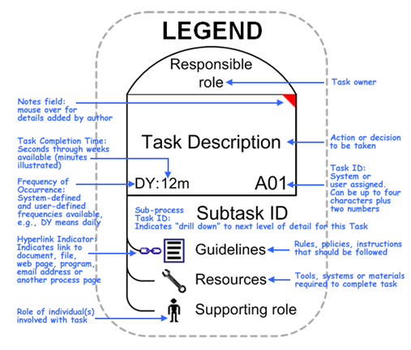
TaskMap Legend

Slide 4
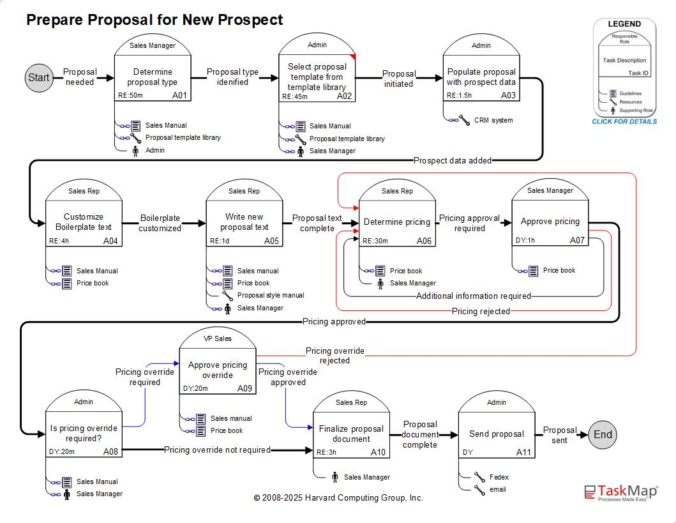
A -- Prepare Proposal
TOC

Slide 5
Summary
TOC

